Slide 1


SMART INDIA HACKATHON 2025
Problem Statement ID – SIH25073
Problem Statement Title- AI-Powered Mobile Platform
For Democratizing Sports Talent Assessment
Theme- Fitness & Sports
PS Category- Software
Team ID- 80065
Team Name- AlgoNomad

Slide 2



Apex Athletic
AlgoNomad
AI-Powered Performance Analyzer
Detailed explanation:
The Sports Authority of India (SAI) requires an innovative, mobile-based solution to democratize sports talent assessment. The proposed platform should:
Record or Upload Drills – Athletes can download an app and either live-record or upload short clips of their sports activities.
AI Video Assessment - Computer vision models analyze movements to measure speed, flexibility, and technique.
Personalized Feedback - AI highlights strengths, detects errors (e.g., running form, bowling action), and gives insights.
Virtual Talent Cards - Each athlete gets a sharable performance card with scores, benchmarks, and progress tracking.
Security - Securely submit verified data to SAI servers for further evaluation and athlete profiling.
How it addresses the problem:
Fair & Accessible - Any athlete with a smartphone can showcase skills, reducing bias and dependency on costly equipment.
Scalable Talent Discovery - Coaches, schools, and colleges can identify hidden talent across regions, not just in urban or elite centers.
Affordable Innovation - Low-cost and lightweight, ensuring accessibility even on entry-level smartphones and low-bandwidth networks.
Innovation and uniqueness of the solution:
Instant Record-to-Feedback – We trained to AI give insights through exclusive skeleton technology built by us.
Talent Cards for Visibility - Creates digital profiles athletes can share with coaches, scouts, and institutions.
Multi-Sport Ready - Flexible framework to adapt to different sports drills and techniques.

Slide 3

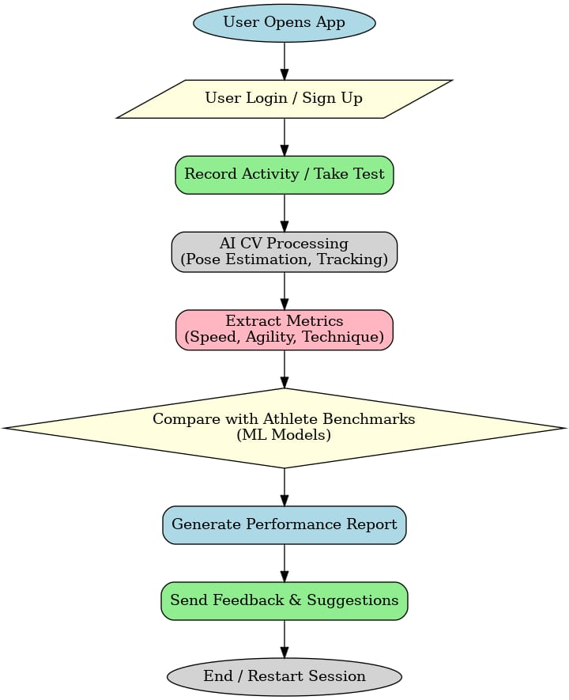
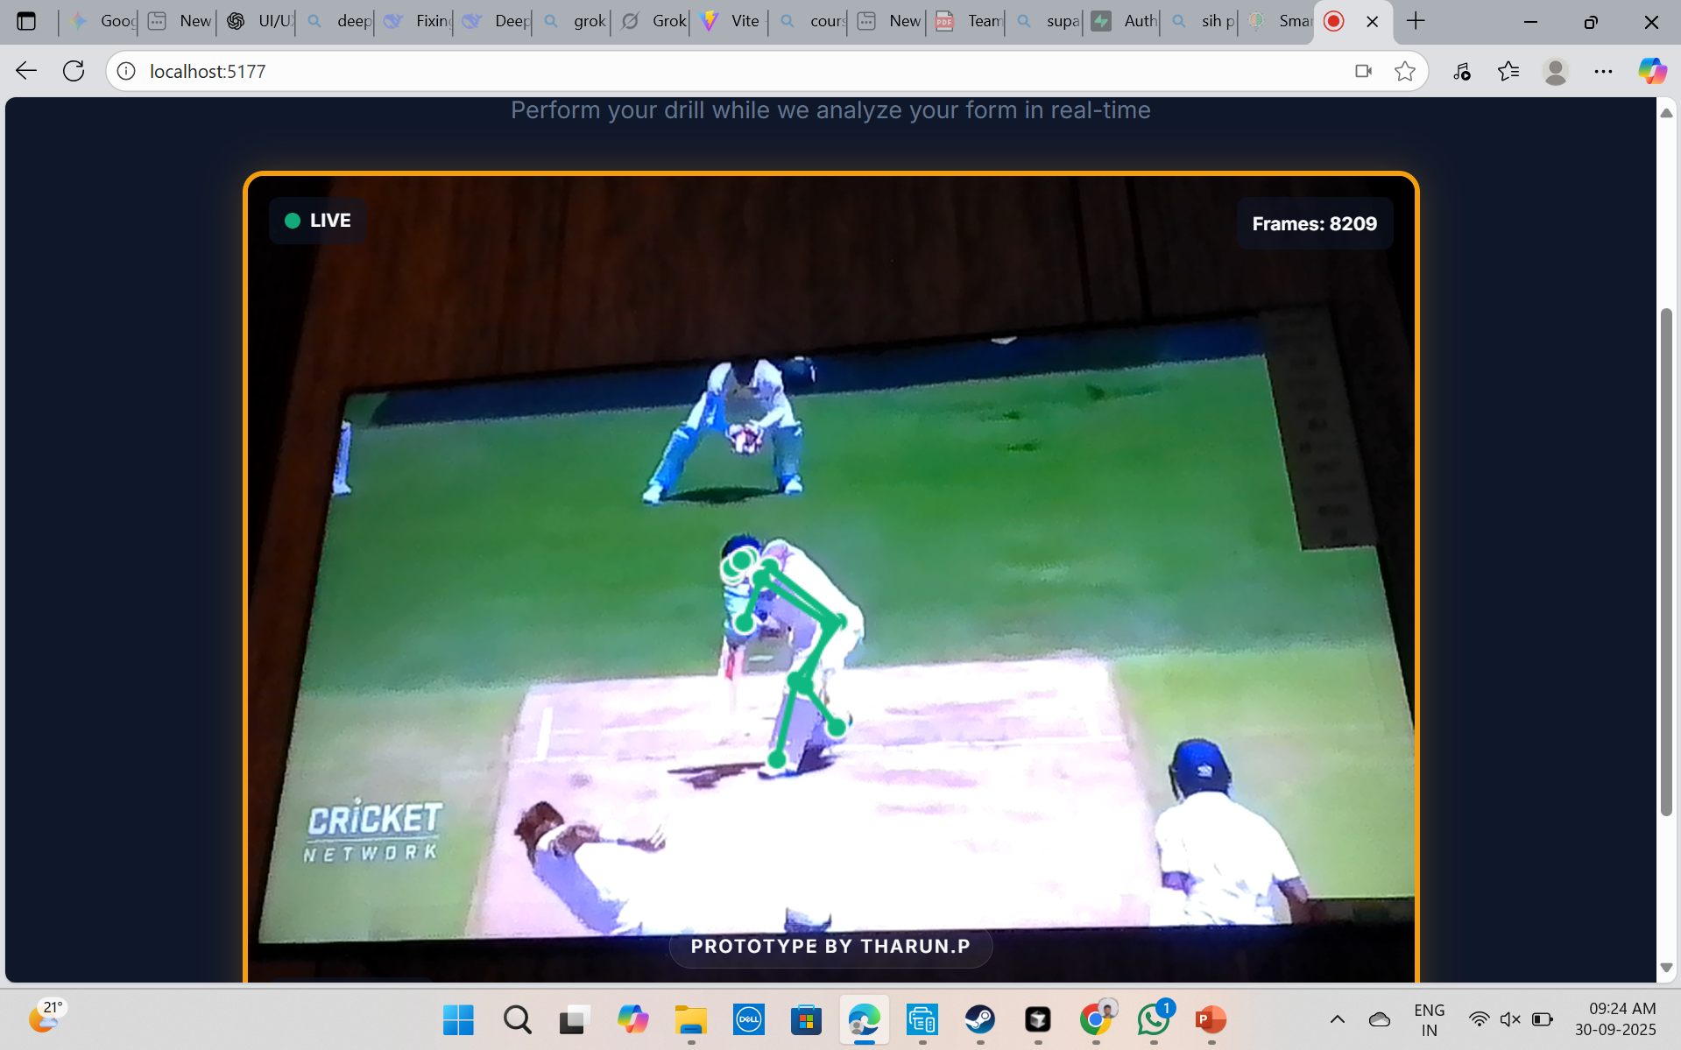
TECHNICAL APPROACH
AlgoNomad
Technologies Used:
Programming Languages & Frameworks:
Mobile App: Flutter / React Vite(TypeScript) (cross-platform iOS & Android)
Backend: Node.js
AI/ML:
Pose Estimation & Motion Tracking: MediaPipe (Skeleton tech)
Video Analysis & Metrics Extraction: TensorFlow
Optional Analytics & Leaderboards: Python (pandas, NumPy)
Database: Supabase (athlete data, scores, leaderboards)
Methodology & Implementation:

Slide 4



FEASIBILITY AND VIABILITY
AlgoNomad
Feasibility:
Technical Feasibility: Any athlete can use just a smartphone to get AI-powered feedback on their performance by our self built tech.
Financial Feasibility: Affordable platform that grows with users, needs minimal investment but offering real impact.
Market Feasibility: Gives hidden talent a chance to be seen and recognized, no matter where they come from.
Operational Feasibility: Easy-to-use app where athletes can upload videos, track progress, and share their talent cards.
Challenges & Risks:
Technical Challenge: Phones and lighting may trick the AI, affecting accurate feedback.
Financial Challenge: Growing the platform while keeping it affordable can stretch resources.
Market Challenge: Talented athletes might never find the app without strong outreach.
Operational Challenge: Protecting user videos and personal data is essential to build trust.
Mitigation Strategies:
Technical Mitigation: Standardize video input and guide users on lighting & angles for accurate AI feedback.
Financial Mitigation: Start lean with minimal costs and add premium features as the user base grows.
Market Mitigation: Launch targeted campaigns and partner with schools/academies to reach hidden talent.
Operational Mitigation: Use encrypted storage, anonymize data, and get clear consent to protect user privacy.

Slide 5

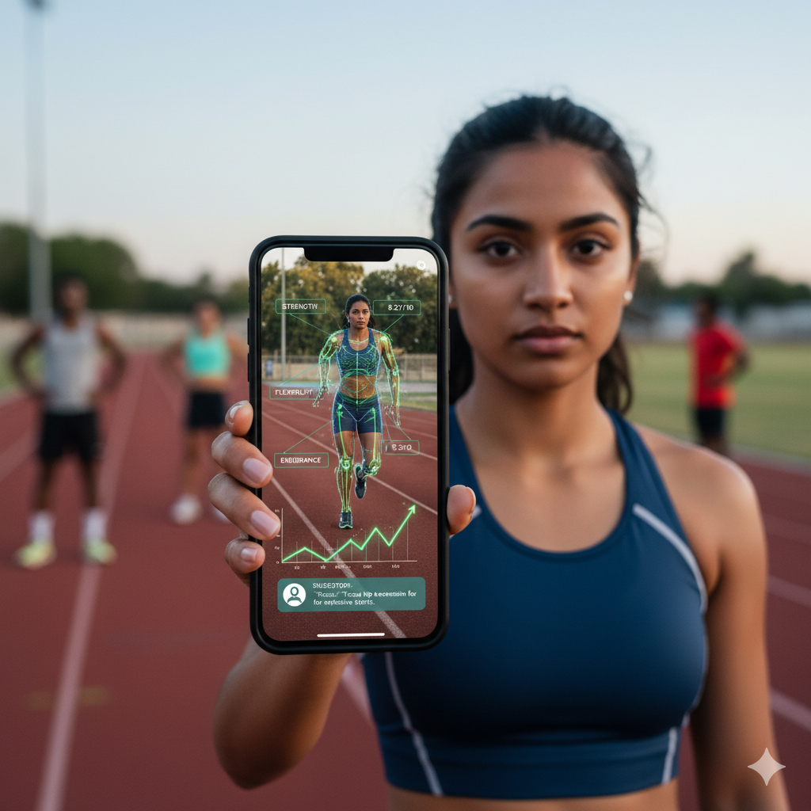
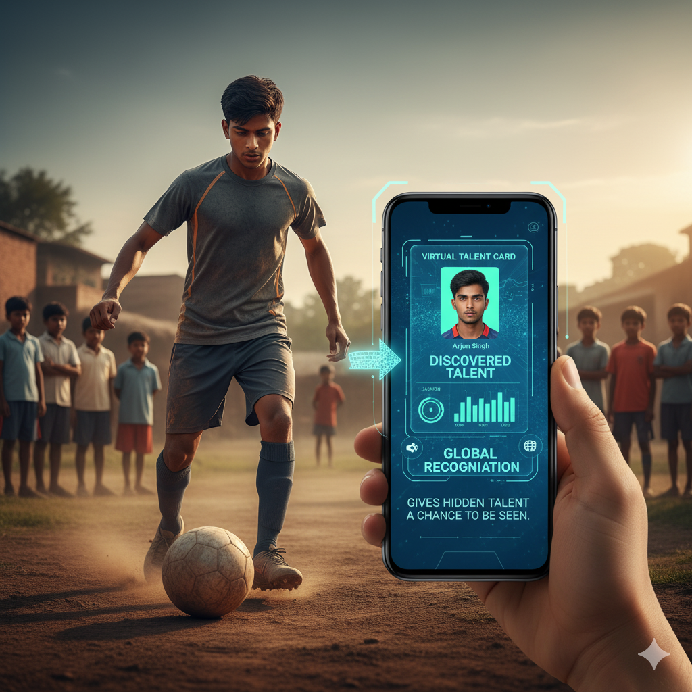

IMPACT AND BENEFITS
AlgoNomad
Potential Impact on Target Audience:
Athletes: Get AI-driven insights to improve skills faster and smarter.
Coaches: Evaluate talent at scale and design personalized training efficiently.
Sports Academies & Schools: Discover hidden talent, giving all athletes a fair chance.
Parents & Guardians: Track progress clearly and safely with understandable metrics.
Benefits of the Solution:
Social: Promotes inclusivity and equal opportunities and reduces scouting bias.
Economic: Saves time and resources which enables cost-effective recruitment for clubs and academies.
Environmental: Cuts travel for trials, assessments happen remotely via mobile.
Educational: Encourages growth through actionable insights and gamified feedback.
Scalable: Easily expands across sports, regions, and age groups with minimal infrastructure.

Slide 6

RESEARCH AND REFERENCES
AlgoNomad
Key Research & Technologies:
AI & Computer Vision in Sports:
Motion analysis and pose estimation using MediaPipe, OpenPose, TensorFlow.
Example studies: “Automated Athlete Performance Analysis Using Pose Estimation”, “Deep Learning for Sports Skill Assessment”.
Talent Identification & Assessment Frameworks:
Research on metrics for agility, speed, endurance, and sport-specific skills.
Example papers: “Objective Metrics for Youth Sports Talent Scouting”, “AI-Based Performance Predicting Athletes”.
Mobile Integration:
Use of smartphones sensors for remote monitoring of athletes.
Example: “Mobile-Based Sports Analytics for Grassroots Talent Development”.
Privacy & Ethical Data Handling:
Guidelines for biometric and video data in sports research.
Reference: GDPR, ISO/IEC 27001, and consent-first data processing studies.
Useful Links / Resources:
MediaPipe Documentation: https://mediapipe.dev
TensorFlow Models for Pose Estimation: https://www.tensorflow.org/hub
OpenPose GitHub: https://github.com/CMU-Perceptual-Computing-Lab/openpose
Research papers: Google Scholar search for “AI sports talent assessment” and “computer vision athlete analysis”.
Prototype website link: https://apex-athletic.web.app/
Youtube link: https://youtu.be/LTqa6NvdWUQ?si=6uCDj2F8f51blJpb

